Slide 1
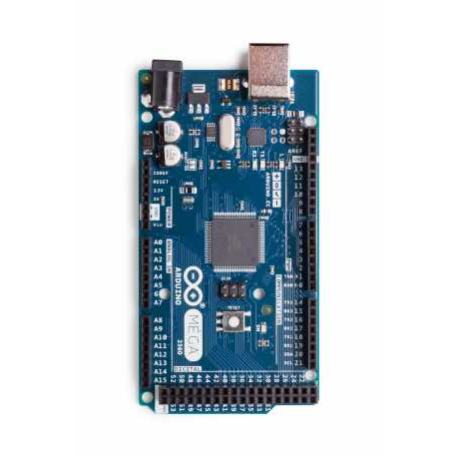
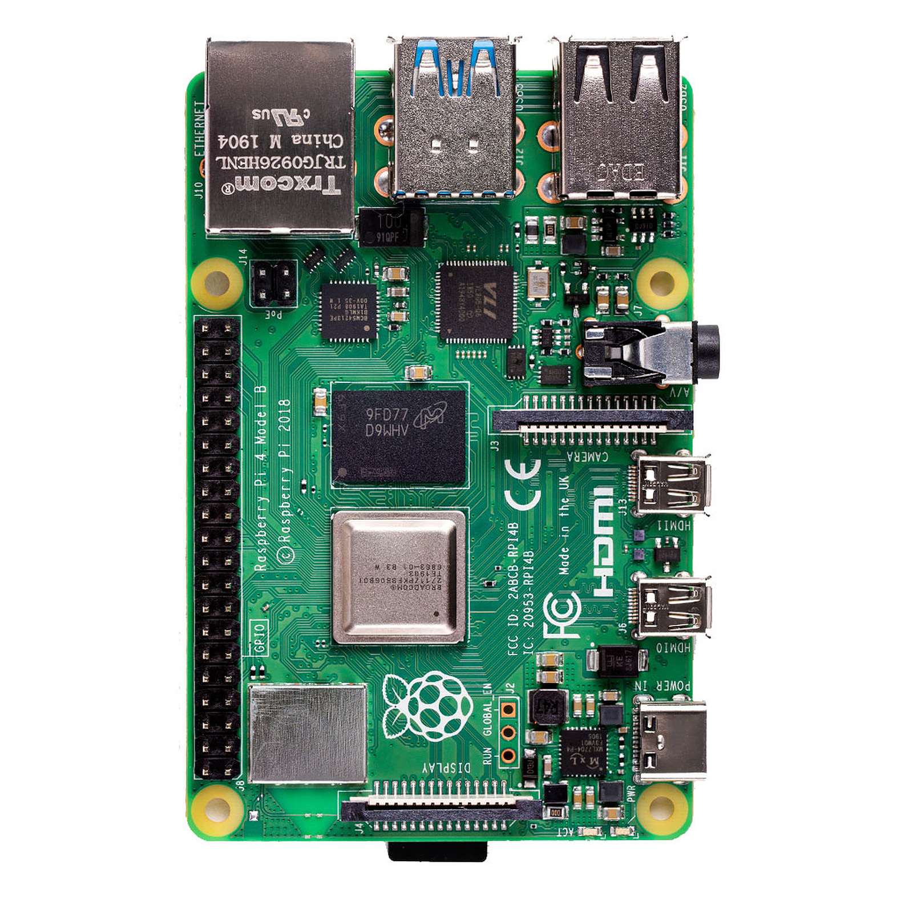
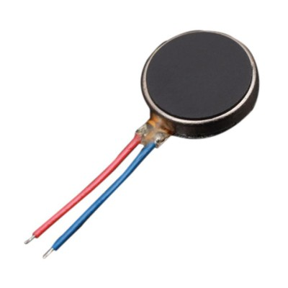
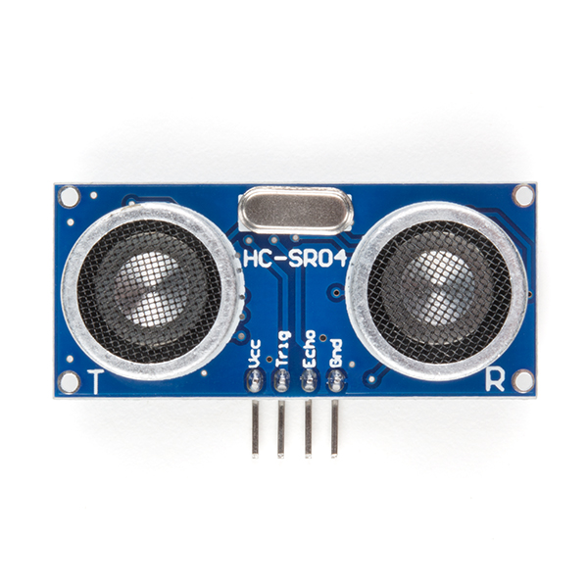
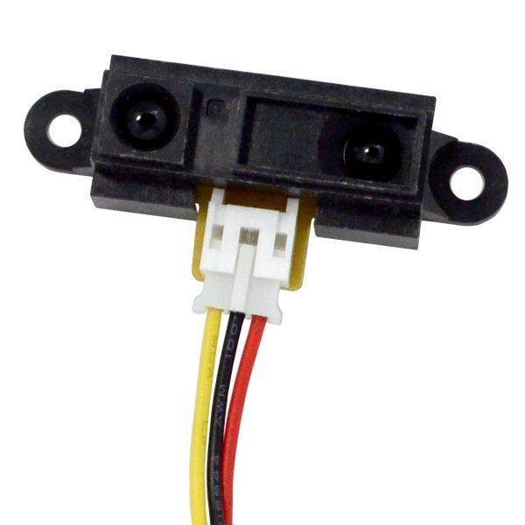
Architecture Diagram
Linked to
Arduino Mega
Activate
Vibration motor
Raspberry PI 4
Send Distance Data
Ultrasonic sensor
Send time between the 2 waves
Sharp IR distance sensor

Slide 2
Architecture Diagram
Send time between the 2 waves
Ultrasonic sensors
Arduino Mega
Raspberry Pi 4
Linked to
Activate
Vibration Motors
Interact with
IR Distance Sensor
Send Distance Data

Slide 3
High Level Function
Wikipedia
Raspberry Pi 4
Talk to
Send SMS
Send & Receive Data
Emergency

